Slide 1


Cloud Based Digital Identity Verification System
Presented by:
T S SAI LAHARI
192325137
CSA1503 Cloud Computing and Big Data Analytics for
Smart cities

Slide 2
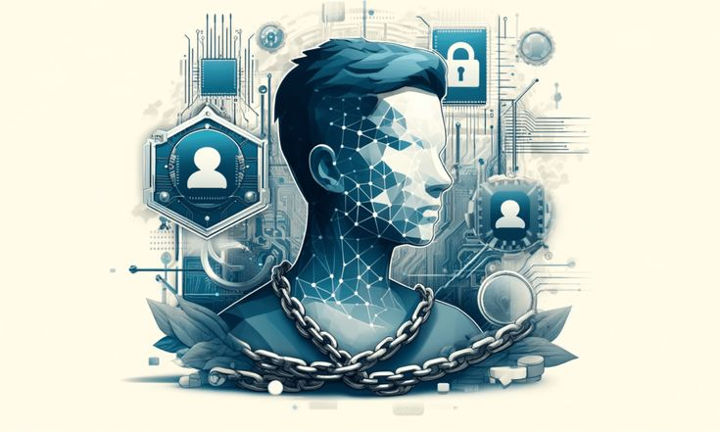
Introduction
Overview of the project:
Build a secure cloud system for digital identity verification.
Enable fast, scalable authentication across devices.
Purpose of the project:
Prevent identity fraud with accurate verification.
Ensure privacy and easy access via the cloud.

Slide 3

Problem Statement
Increasing identity fraud and data breaches compromise user security.
Manual identity verification processes are slow, inefficient, and costly.
Lack of a unified global digital identity framework creates compliance challenges.
Businesses require a scalable, automated, and cost-effective solution for identity verification.

Slide 4
Objectives
Implement a secure, scalable identity verification system
Enable remote verification via cloud infrastructure.
Use AI-driven document and biometric authentication.
Ensure compliance with global data protection laws

Slide 5
Literature Review / Background
Summary of Existing Research:
Previous studies focus on cloud-based identity verification using biometrics, encryption, and multi-factor authentication to improve security and accessibility.
Theoretical Foundation:
While current methods enhance authentication accuracy, there is a need for more scalable, privacy-preserving solutions that leverage cloud computing to handle large user bases efficiently.

Slide 6
Methodology
Tools & Frameworks Used: Python, OpenCV, face_recognition, Flask (for UI/API), Azure Face API (optional), NumPy, PIL, SQLite (for identity storage)
Development Approach: Implement face detection and feature extraction, integrate facial similarity scoring using local or cloud-based models, and iteratively test verification accuracy. Refine threshold values to optimize false acceptance and rejection rates.
Data Collection (if applicable): Capture or upload ID photos and real-time selfies for matching. Public datasets like LFW (Labeled Faces in the Wild) used for initial model training and testing.

Slide 7
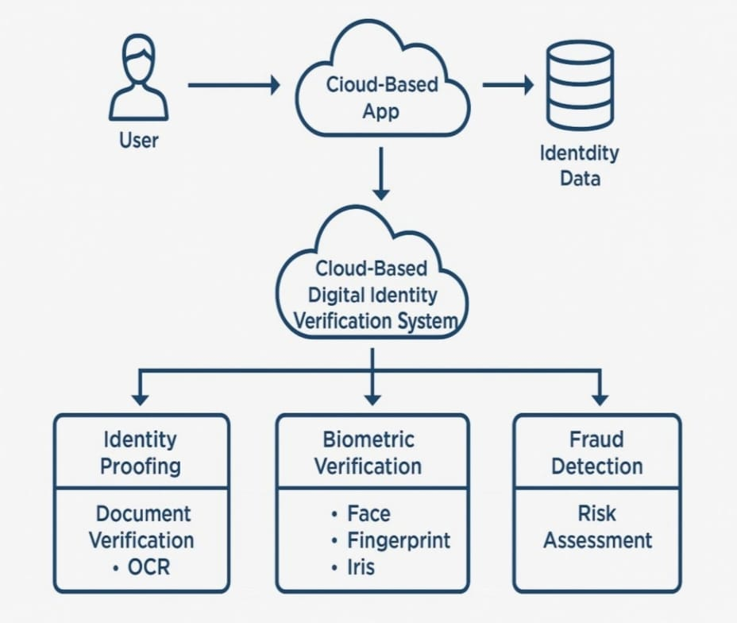
System Architecture

Slide 8
Core Technologies:
Python + Flask → Web framework for handling uploads and serving the interface.
OpenCV → Reads and processes face images (grayscale conversion, resizing).
SSIM (Structural Similarity Index) → Measures facial similarity between two images (score > 0.7 = Verified).
Flask Templates (HTML) → Renders upload form and displays results.
Werkzeug – secure_filename → Ensures secure file uploads by avoiding directory traversal.

Slide 9
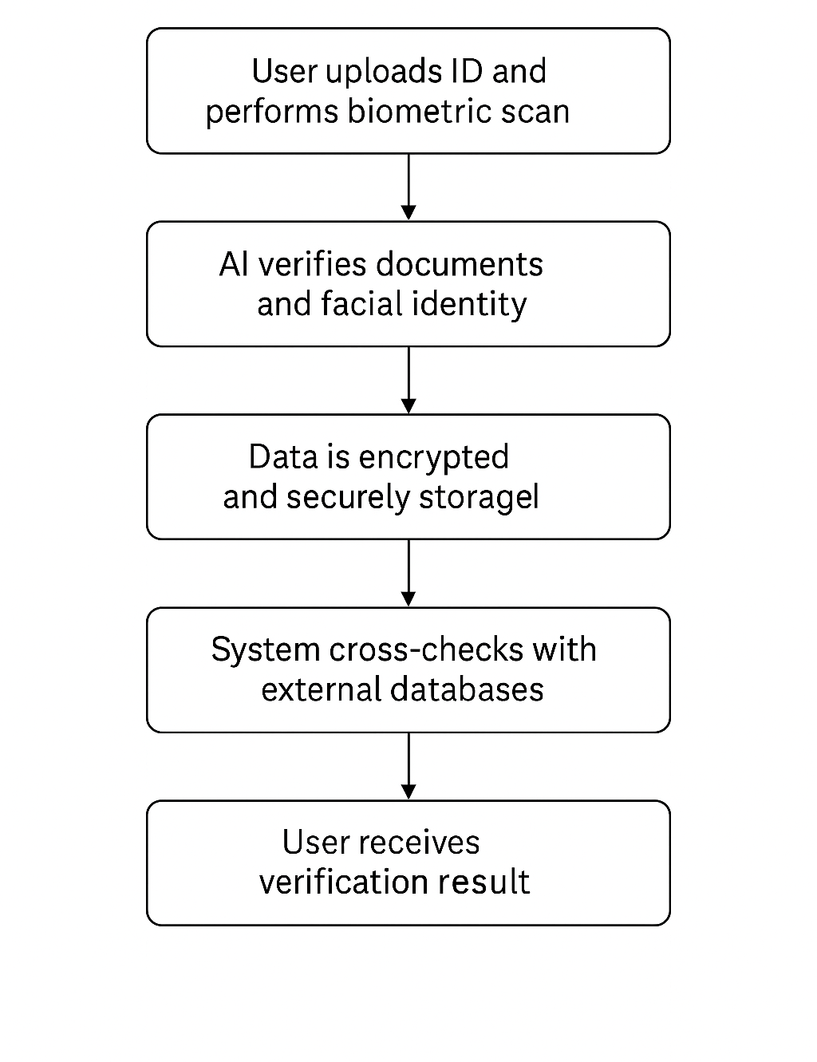
Implementation workflow

Slide 10
Code
from flask import Flask, render_template, request, url_for
from pathlib import Path
from werkzeug.utils import secure_filename
from skimage.metrics import structural_similarity as ssim
import cv2
app = Flask(__name__)
# Use absolute path to avoid "static \ uploads" bug
BASE_DIR = Path(__file__).resolve().parent
UPLOAD_FOLDER = BASE_DIR / 'static' / 'uploads'
UPLOAD_FOLDER.mkdir(parents=True, exist_ok=True)
app.config['UPLOAD_FOLDER'] = str(UPLOAD_FOLDER)
def compare_faces(img1_path, img2_path):
img1 = cv2.imread(str(img1_path))
img2 = cv2.imread(str(img2_path))
img1_gray = cv2.cvtColor(img1, cv2.COLOR_BGR2GRAY)
img2_gray = cv2.cvtColor(img2, cv2.COLOR_BGR2GRAY)
img2_gray = cv2.resize(img2_gray, (img1_gray.shape[1], img1_gray.shape[0]))
score, _ = ssim(img1_gray, img2_gray, full=True)
result = "✅ Identity Verified: Faces are similar." if score > 0.7 else "❌ Identity Verification Failed: Faces are different."
return result, score

Slide 11
@app.route('/', methods=['GET', 'POST'])
def index():
result = None
score = None
img1_url = None
img2_url = None
if request.method == 'POST':
img1 = request.files['img1']
img2 = request.files['img2']
img1_filename = secure_filename(img1.filename)
img2_filename = secure_filename(img2.filename)
img1_path = UPLOAD_FOLDER / img1_filename
img2_path = UPLOAD_FOLDER / img2_filename
img1.save(str(img1_path))
img2.save(str(img2_path))
result, score = compare_faces(img1_path, img2_path)
img1_url = url_for('static', filename=f'uploads/{img1_filename}')
img2_url = url_for('static', filename=f'uploads/{img2_filename}')
return render_template('index.html', result=result, score=score, img1_url=img1_url, img2_url=img2_url)
if __name__ == '__main__':
app.run(debug=True)

Slide 12
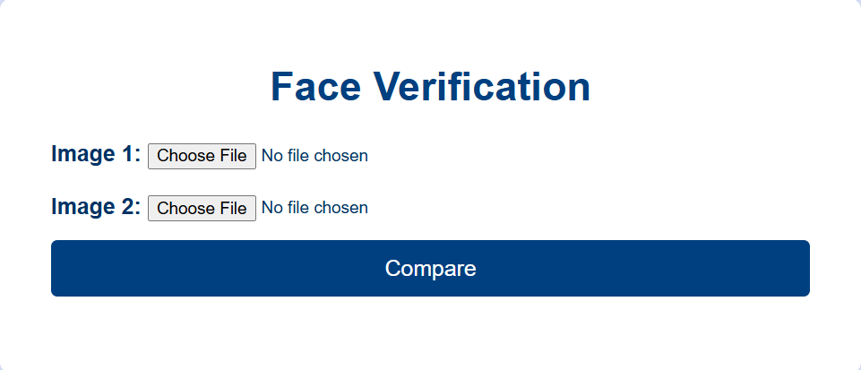
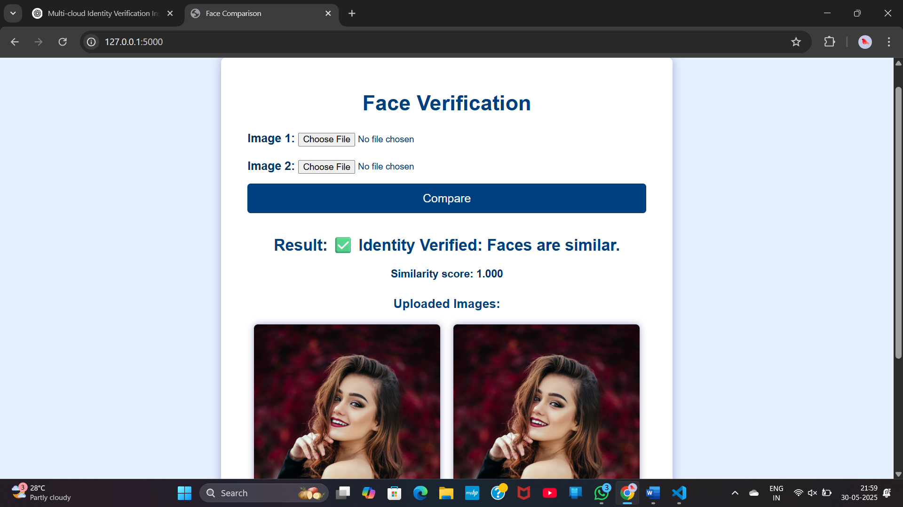
Output Screenshot

Slide 13
Results & Discussion
Comparison with Existing Solutions:
Feature | Traditional Manual Verification | On-Premise Systems | Our Cloud-Based System
Processing Time | Hours to days | Minutes to hours | Seconds
Scalability | Low | Medium | High (scalable on demand)
Accuracy | Depends on human judgment | Moderate | High (advanced face matching)
Real-Time Verification | No | Limited | Yes
Maintenance | High | Moderate | Low (cloud managed)

Slide 14

Challenges & Limitations
Sensitive information can be hacked or leaked.
Needs a good internet connection to work properly.
Cloud processing can cause delays.
Different countries have different privacy laws.
Hard to connect with old systems or other apps.

Slide 15

USE CASES
Online Banking: Verifying customers identities before opening accounts or approving transactions.
E-commerce: Confirming buyer or seller identities to prevent fraud.
Remote Employee Onboarding: Checking new employees identities without needing physical presence.
Access Control: Allowing secure entry to buildings or systems based on verified digital IDs.
Government Services: Verifying citizens’ identity for benefits, voting, or tax filing online.

Slide 16
Future Scope
Enhancements or improvements:
Multi-Language Support:- Extend code generation to Java, JavaScript, and other programming languages.
IDE Integration:- Implement plugins for VS Code, PyCharm, and other development environments.
Future Extensions of the Project:
Multi-Language Code Generation:- Expand support for Java, JavaScript, C#, and more.
Integration with Al Models:-Use advanced Al like GPT-4 or Codex for smarter code suggestions.

Slide 17

Conclusion
Cloud-based identity verification enhances security, efficiency, and compliance.
AI and blockchain improve fraud detection and trust in digital identity.
The system adapts to various industries and regulatory standards.
Future advancements will strengthen identity security and global adoption.
By integrating AI and blockchain, the solution ensures a seamless, fast, and reliable identity verification process.
Widespread adoption of such systems can significantly reduce fraud and unauthorized access.

Slide 18
References
National Institute of Standards and Technology (NIST) – Cloud Security and Identity Management Guidelines (NIST SP 800-53, NIST SP 800-63) Available at: https://www.nist.gov/
• General Data Protection Regulation (GDPR) – European Union Cloud Data Privacy Regulations Available at: https://gdpr.eu/
• ISO/IEC 27017 – Cloud Security Controls for Service Providers and Users Available at: https://www.iso.org/standard/43757.html
FIDO2 & WebAuthn Standards – Passwordless Authentication Framework Available at: https://fidoalliance.org/

Slide 19
Books :
Cloud Computing: Concepts, Technology & Architecture
Biometric Systems: Technology, Design and Performance Evaluation
Security and Privacy in Biometrics
Cloud Security and Privacy
Research Papers:
Digital identity management: Technological, business and social implications
A framework for secure digital identity management in cloud computing

Slide 20
Thank You!

